Slide 1
History of Money

Slide 2
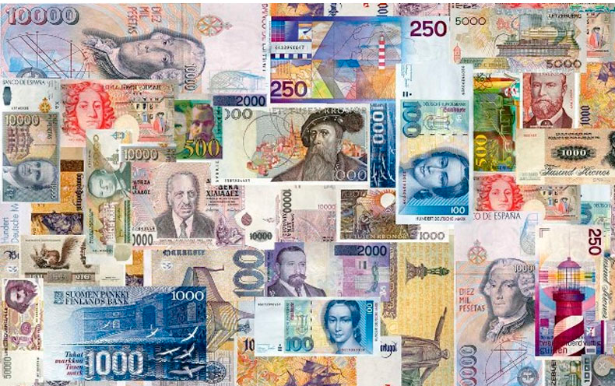
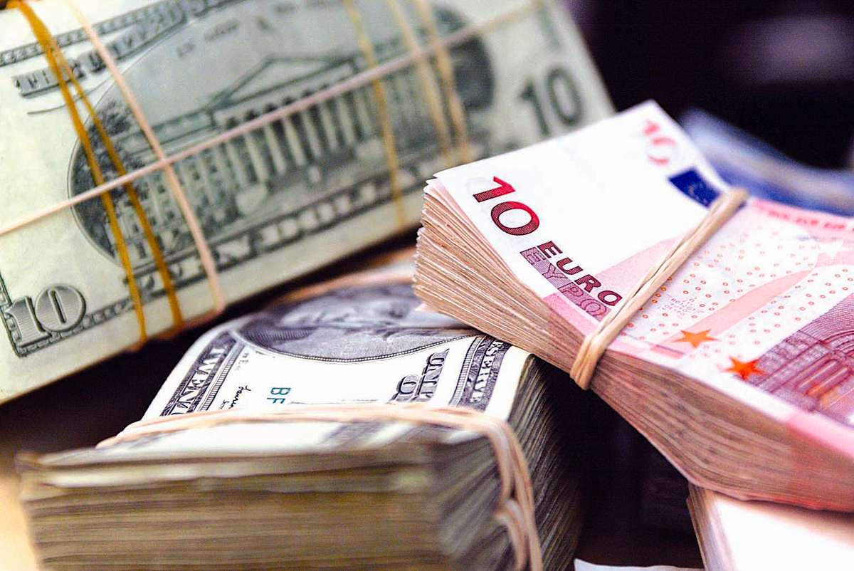
Money is basically a method of exchange,
and coins and notes are just items of exchange

Slide 3
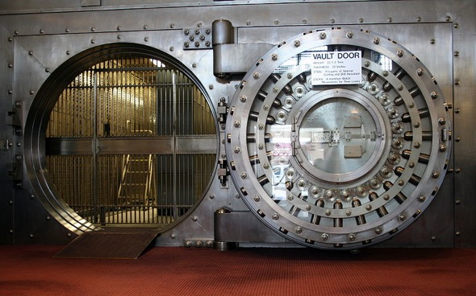

Bank of Sweden
1661
in Europe

Slide 4
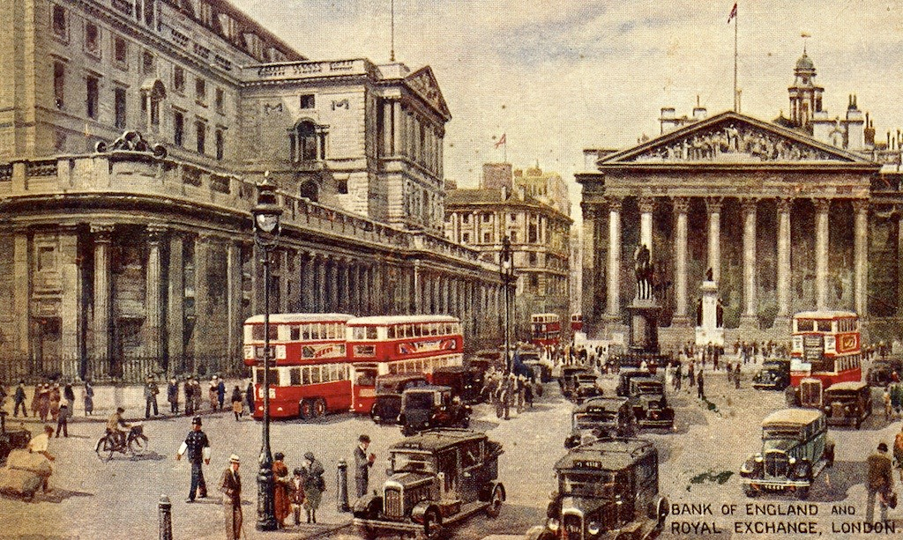
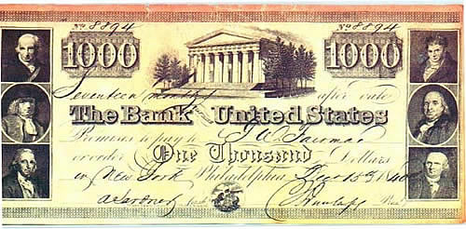
In 1694 the Bank of England was founded
promissory notes

Slide 5
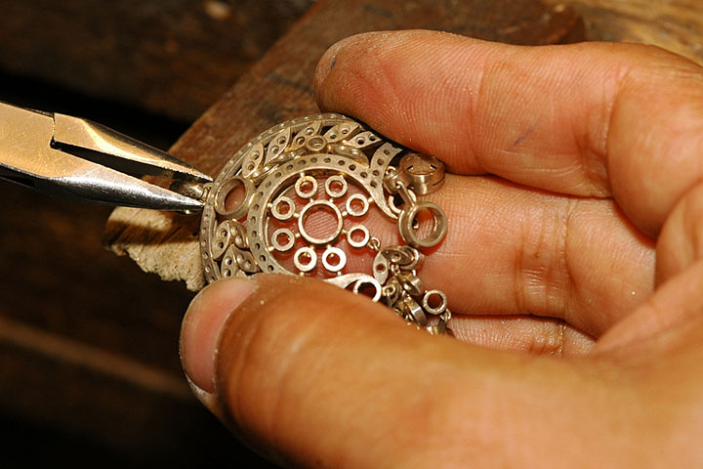

traveling with gold was dangerous
jewelers

Slide 6
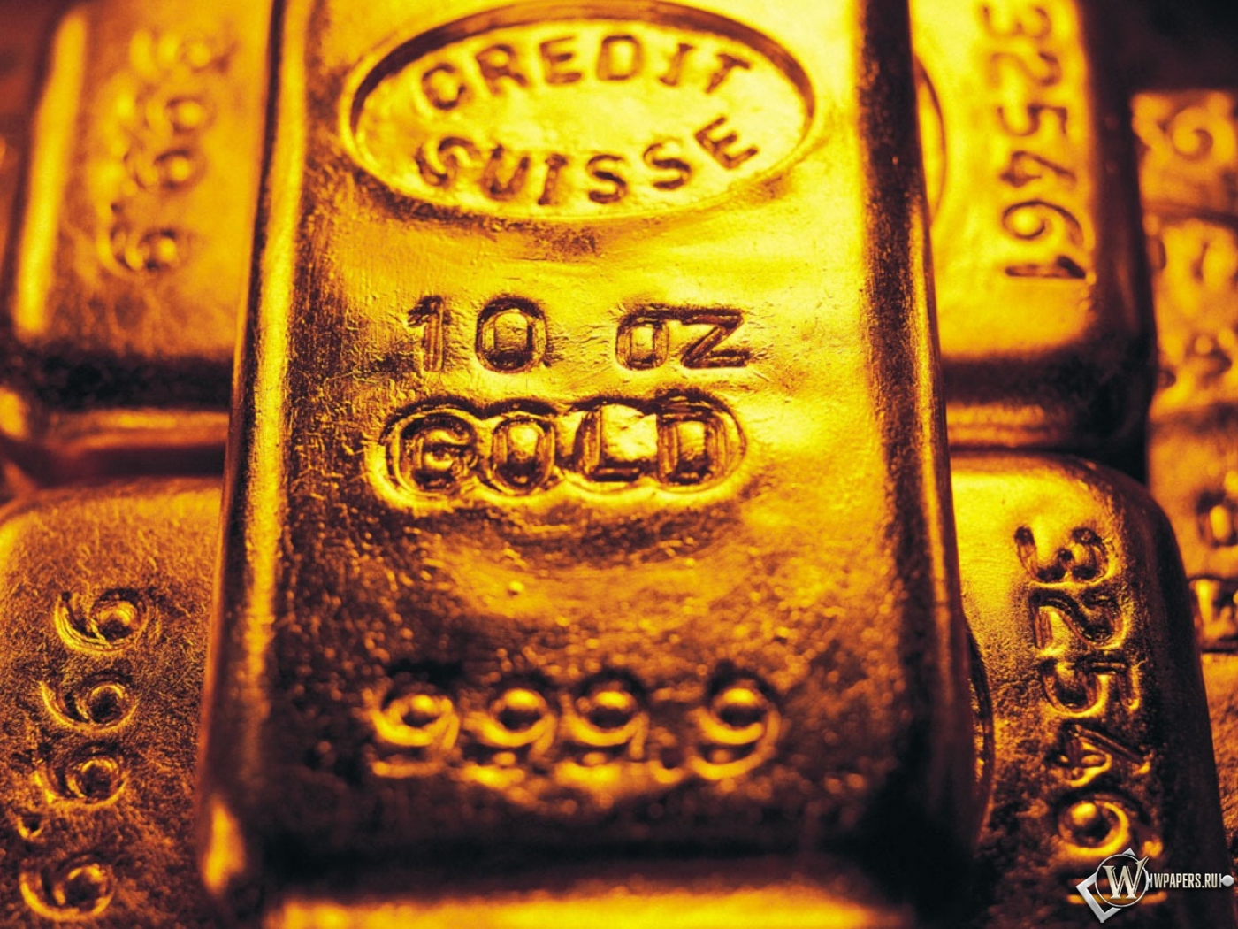
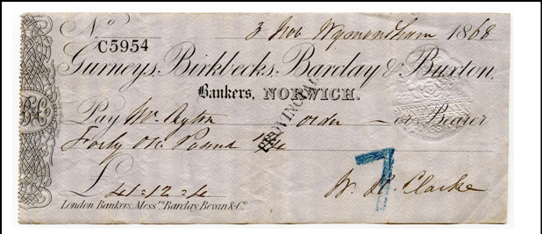
Cheque
the note could trade
the note in for gold

Slide 7
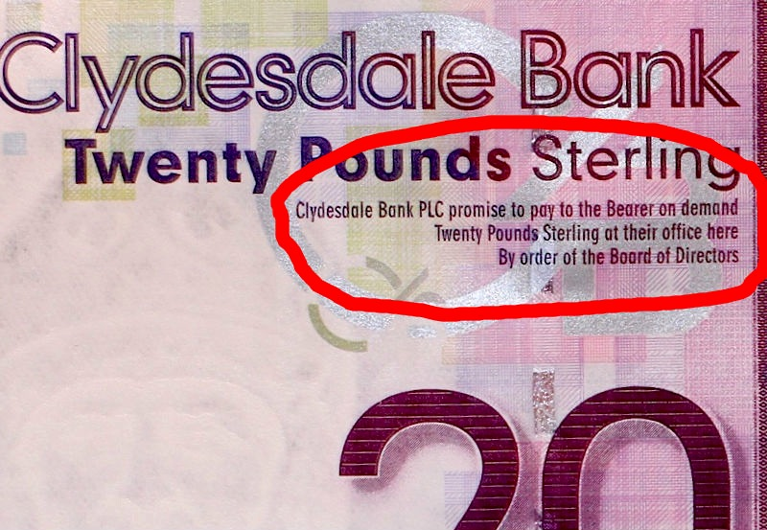
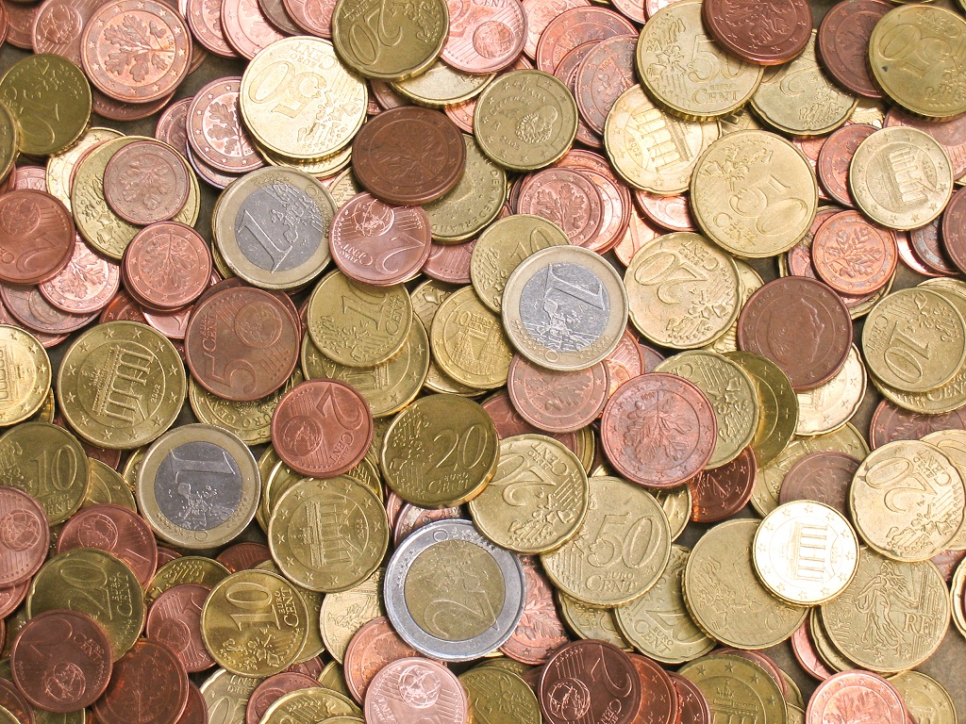
These promissory notes were the beginning of paper money in Europe

Slide 8


